Slide 1
Hierarchical Clustering

Slide 2
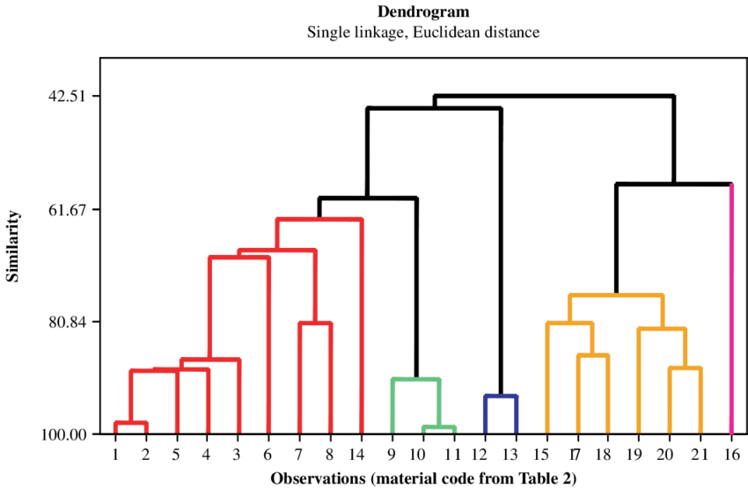
Introduction
Hierarchical clustering is another unsupervised machine learning algorithm, which is used to group the unlabeled datasets into a cluster and also known as hierarchical cluster analysis or HCA.
Hierarchical clustering is an unsupervised learning technique used to group similar objects into clusters. It creates a hierarchy of clusters by merging or splitting them based on similarity measures.
Hierarchical clustering groups similar objects into a dendrogram. It merges similar clusters iteratively, starting with each data point as a separate cluster. This creates a tree-like structure that shows the relationships between clusters and their hierarchy.
The dendrogram from hierarchical clustering reveals the hierarchy of clusters at different levels, highlighting natural groupings in the data. It provides a visual representation of the relationships between clusters, helping to identify patterns and outliers, making it a useful tool for exploratory data analysis

Slide 3
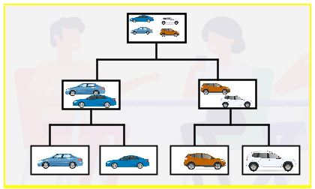
Example
Hierarchical clustering is separating data into groups based on some measure of similarity, finding a way to measure how they’re alike and different, and further narrowing down the data.
Let's consider that we have a set of cars and we want to group similar ones together. Look at the image shown below:
For starters, we have four cars that we can put into two clusters of car types: sedan and SUV. Next, we'll bunch the sedans and the SUVs together. For the last step, we can group everything into one cluster and finish when we’re left with only one cluster.

Slide 4
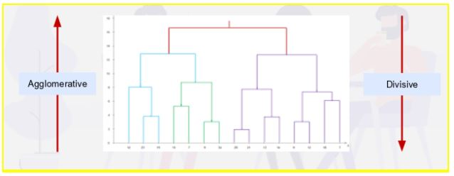
Types of Hierarchical Clustering
Hierarchical clustering is divided into:
Agglomerative
Divisive
Divisive Clustering
Divisive clustering is known as the top-down approach. We take a large cluster and start dividing it into two, three, four, or more clusters.
Agglomerative Clustering
Agglomerative clustering is known as a bottom-up approach. Consider it as bringing things together.

Slide 5
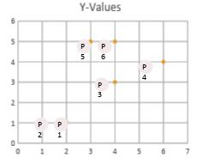
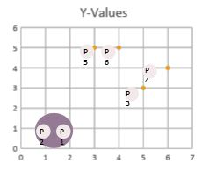
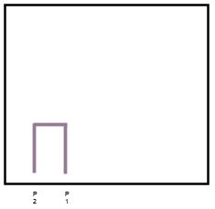
How Does Hierarchical Clustering Work?
Here, each data point is a cluster of its own. We want to determine a way to compute the distance between each of these points. For this, we try to find the shortest distance between any two data points to form a cluster.
Once we find those with the least distance between them, we start grouping them together and forming clusters of multiple points.

Slide 6
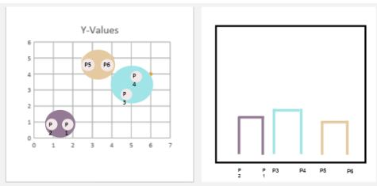
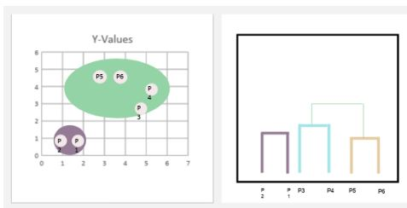
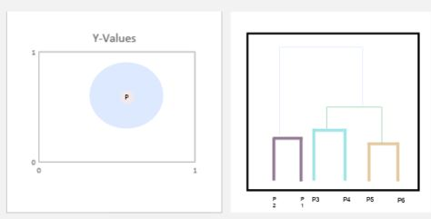
As a result, we have three groups: P1-P2, P3-P4, and P5-P6. Similarly, we have three dendrograms, as shown below:
In the next step, we bring two groups together. Now the two groups P3-P4 and P5-P6 are all under one dendrogram because they're closer together than the P1-P2 group. This is as shown below:
We finish when we’re left with one cluster and finally bring everything together.
The cluster on the right went to the top with the gray hierarchical box connecting them.

Slide 7
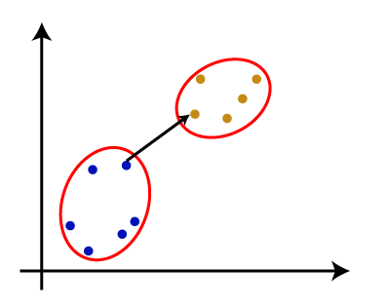
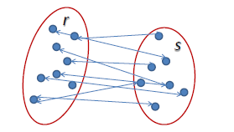
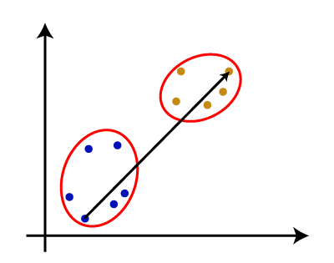
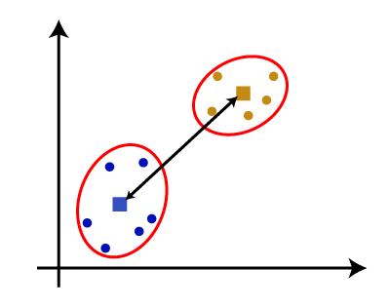
Measure for the distance between two clusters
As we have seen, the closest distance between the two clusters is crucial for the hierarchical clustering. There are various ways to calculate the distance between two clusters, and these ways decide the rule for clustering. These measures are called Linkage methods.
Single Linkage: It is the Shortest Distance between the closest points of the clusters.
3. Average Linkage: It is the linkage method in which the distance between each pair of datasets is added up and then divided by the total number of datasets to calculate the average distance between two clusters. It is also one of the most popular linkage methods.
2. Complete Linkage: It is the farthest distance between the two points of two different clusters. It is one of the popular linkage methods as it forms tighter clusters than single-linkage.
4. Centroid Linkage: It is the linkage method in which the distance between the centroid of the clusters is calculated.

Slide 8
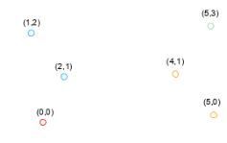
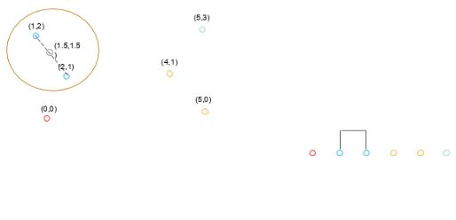
What is Agglomerative Clustering?
Let's assume that we have six data points in a Euclidean space. We're dealing with X-Y dimensions in such a case.
Here, we will make use of centroids, which is the average of its points. Let’s first take the points 1.2 and 2.1, and we’ll group them together because they're close. For these points, we compute a point in the middle and mark it as (1.5,1.5). It’s the centroid of those two points.

Slide 9
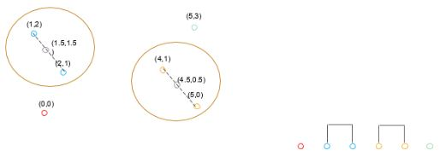
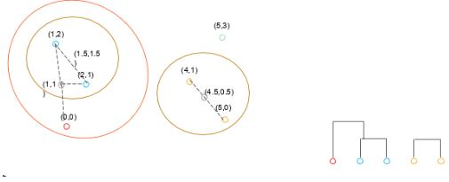
Next, we measure the other group of points by taking 4.1 and 5.0. We set up a centroid of those two points as (4.5,0.5).
Once we have the centroid of the two groups, we see that the next closest point to a centroid (1.5, 1.5) is (0,0) and group them, computing a new centroid based on those three points. The new centroid will be (1,1).

Slide 10
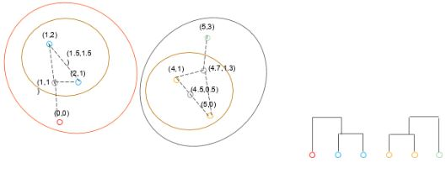
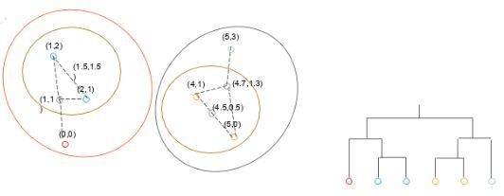
We do the same with the last point (5,3), and it computes into the first group. You can see that the dendrogram on the right is growing. Now each of these points is connected. We group them, and finally, we get a centroid of that group, too, at (4.7,1.3).
Finally, we combine the two groups by their centroids and end up with one large group that has its centroid. Usually, we don't compute the last centroid; we just put them all together.

